Slide 1
Trip Planner

Slide 2
INTRODUCTION
This report consists of the details regarding the project done for Final Project Submission. The project is about building an android application which bestow its users the reliability to book the hotel on minimal price with ‘book a ride’ options.
It’s android application that allows you to make online hotel reservations. It owes its increasing popularity to:
Convenience – saves you tons of time net surfing, talking to agents, phoning hotels, etc.
Security – a user’s privacy and financial information is protected.
Cost-effectiveness – allows spotting deals and taking advantage of loyalty programs

Slide 3
Abstract
This android application has been developed on Android Studio version 3.1.2. It has been named “Trip Planner”. It just requires user to input their phone number just by entering their phone number and an OTP will be used to verify the user. Authenticated user records can be seen on firebase database Firebase provides a real-time database and backend as a service. The database or the records is being managed very dynamically. One can view the records on Firebase. After authentication, user can book hotels with complimentary breakfast and ‘book a ride’ option. Trip Planner have transparent business model, it lets users to pay on arrival on any booking.
The android package kit (APK) is of only about 41 Megabytes.

Slide 4
Chapter 1.
Frameworks and Platform
This chapter will describe in brief, all the frameworks and technologies which have been used throughout the development of the application.
1.1. Android Studio
Android Studio is the official integrated development environment (IDE) for the Android platform.
1.1.1. Features
• Gradle-based build support
• Android-specific refactoring and quick fixes
• Built-in support for Google Cloud Platform, enabling integration with Firebase Cloud Messaging (Earlier 'Google Cloud Messaging') and Google App Engine
• Android Virtual Device (Emulator) to run and debug apps

Slide 5
1.2 Android SDK
The Android SDK (Software Development Kit) is a set of development tools used to develop applications for Android platform.
1.3. JAVA
Java is a general-purpose computer programming language that is concurrent, class-based, object-oriented and specifically designed to have as few implementation dependencies as possible.
1.4. JAVA Development Kit (JDK)
The Java Development Kit (JDK) is a software development environment used for developing Java applications and applets. It includes the Java Runtime Environment (JRE), an interpreter/loader (java), a compiler (javac), an archiver (jar), a documentation generator (javadoc) and other tools needed in Java development.

Slide 6
1.5. XML
In computing, Extensible Markup Language (XML) is a markup language that defines a set of rules for encoding documents in a format that is both human-readable and machine-readable.
1.6. NoSQL
The Firebase Real-time Database is a cloud-hosted database. Data is stored as JSON and synchronized in real-time to every connected client.
A NoSQL (originally referring to "non SQL” or "non-relational") database provides a mechanism for storage and retrieval of data that is modelled in means other than the tabular relations used in relational databases.
1.4. JAVA Development Kit (JDK)
The Java Development Kit (JDK) is a software development environment used for developing Java applications and applets. It includes the Java Runtime Environment (JRE), an interpreter/loader (java), a compiler (javac), an archiver (jar), a documentation generator (javadoc) and other tools needed in Java development.

Slide 7
Chapter 2.
One-Time Password or PIN (OTP)
A one-time password or pin (OTP) is a password that is valid for only one login session or transaction, on a computer system or other digital device.
OTP is used to authenticate the user to distinguish between valid and non-valid customers. This feature doesn’t requires password to remember, you can login anytime, anywhere using your registered mobile number.
Our application uses this features with auto enabled function in which user doesn’t have to enter OTP, the application will automatically detect the OTP and authenticate, if the user is already registered or it’ll be directed to registration page for a new user.

Slide 8
Chapter 3.
System Analysis
In this chapter, we will discuss and analyise about the developing process of trip planner application including software requirenment specification(SRS) and comparison between existing and proposed application. The functional and non functional requirenment are included in SRS part to provide complete description and overview of system requirement before the developing process in carried out

Slide 9
3.1. System requirements
3.1.1. Non functional requirements
Efficiency requirements
When a user meets this application, this application will easily allow the user to access the hotels and book according to their need
Reliability requirement
The application should accurately perform user registration, validation and search their requirement.
Usability requirement
The application is designed for a user friendly environment so that the user can perform the various tasks easily and in an effective way

Slide 10
3.1.2. Functional requirements
1. Normal user
1.1. User login
Description of feature
This feature is used by the user to login into the application. They are required to entered the registered mobile number or to register for a new user before they are allowed to enter the application. The mobile number will be verified using OTP and if invalid the user is not allowed to enter the application
Functional requirements
Mobile number is required for registered user
An OTP will be sent to verify the user
The system performs
Authorization process which decides the user to access the application
User must be able to logout after they finished using application

Slide 11
1.2. Register New User
Description of feature
This feature can be performed by all users to register new user to
create account.
Functional requirements
Application must be able to verify information
Application must be able to delete information if information is wrong

Slide 12
1.3. Search for booking
Description of feature
This feature is found in the application once the user successfully login into their account. User can search hotels according to their requirement
Functional requirements
Application must be able to search the database based on search type
Application must be able to filter based on key word entered
Application must be able to show the filtered result in table view.

Slide 13
3.1.3. Software requirement
Operating System
minimum supported SDK is 19 which is Android 4.4 (kitkat). Target SDK is 27 which is Android 8.1(Oreo) as it is most stable, latest and have more user database.
Database
Firebase NoSQL real-time database is used.
Development tools and programming language
JAVA is used to write whole backend code and XML is used for styling work and firebase is used for server side scripting.

Slide 14
Chapter 4.
Some chapters, coming next, will elaborate the graphical interface of the application by some screenshots from Moto E4 Plus (Android 8.1):

Slide 15
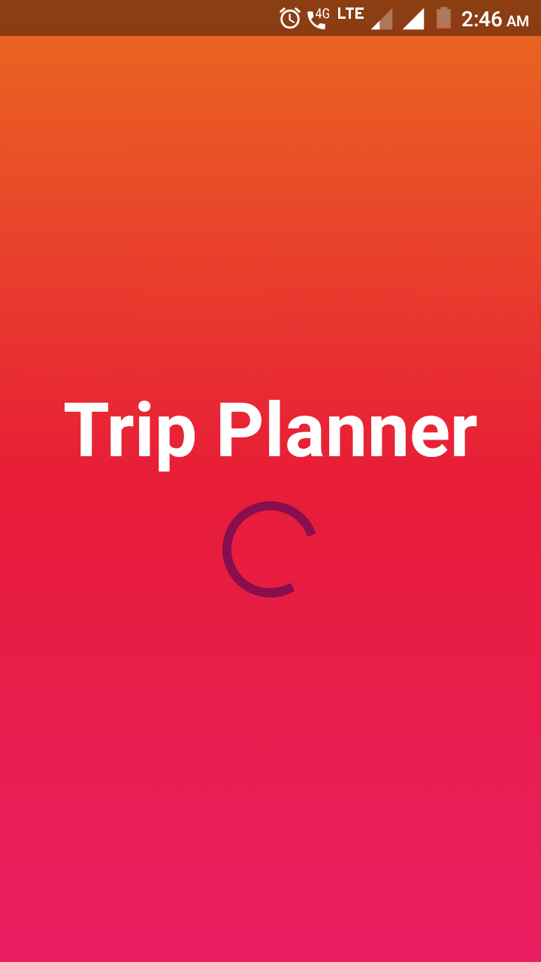
4.1. Splash Screen page
Splash Screen page of the application looks as it is depicted by the screenshot. The name of the application is displayed at the centre of the screen with circular progressive bar which check first if the internet option is enabled or not, if yes then it checks whether the previous user has logged out successfully or not, if not then it will lead to home page directly and if yes, then it’ll redirect user to Intro Screen page where user will be shown some special services and facilities provided by our application.

Slide 16
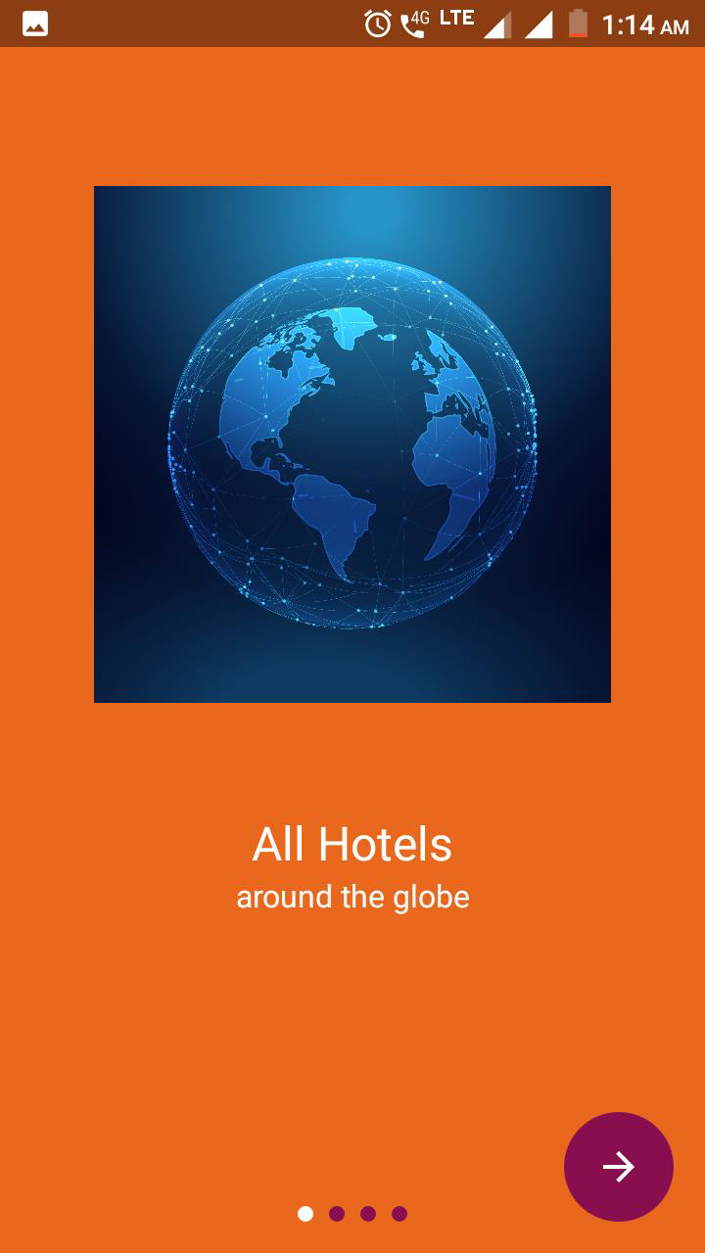
4.2. Intro Screen Page
Intro Screen page of the application looks as it is depicted by the screenshot. The facilities and services provided by the application is displayed at the centre of the screen. This is supported by skip option and swipe gesture to go to next page, back button.
1st Intro Page
“All Hotels, Around the Globe”

Slide 17
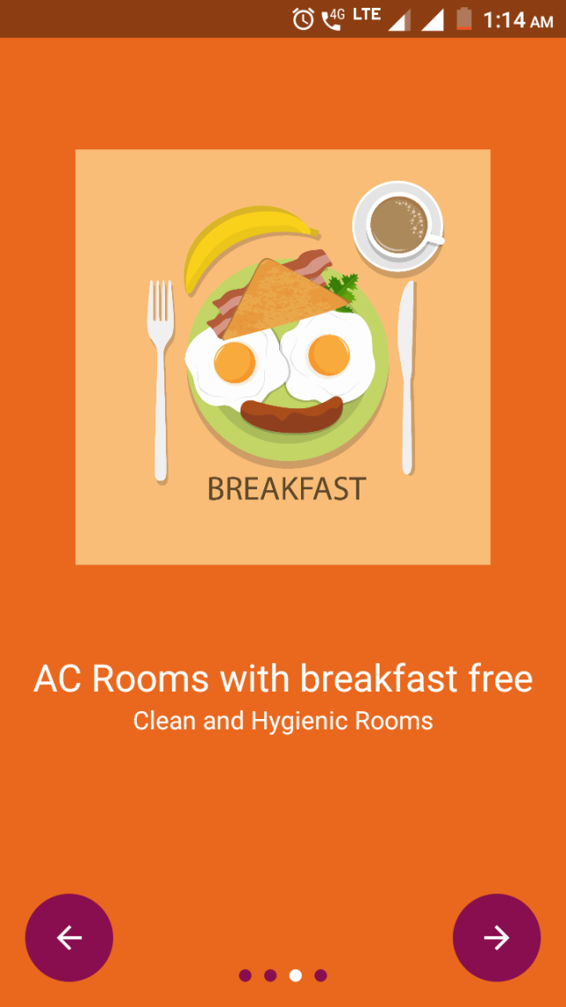
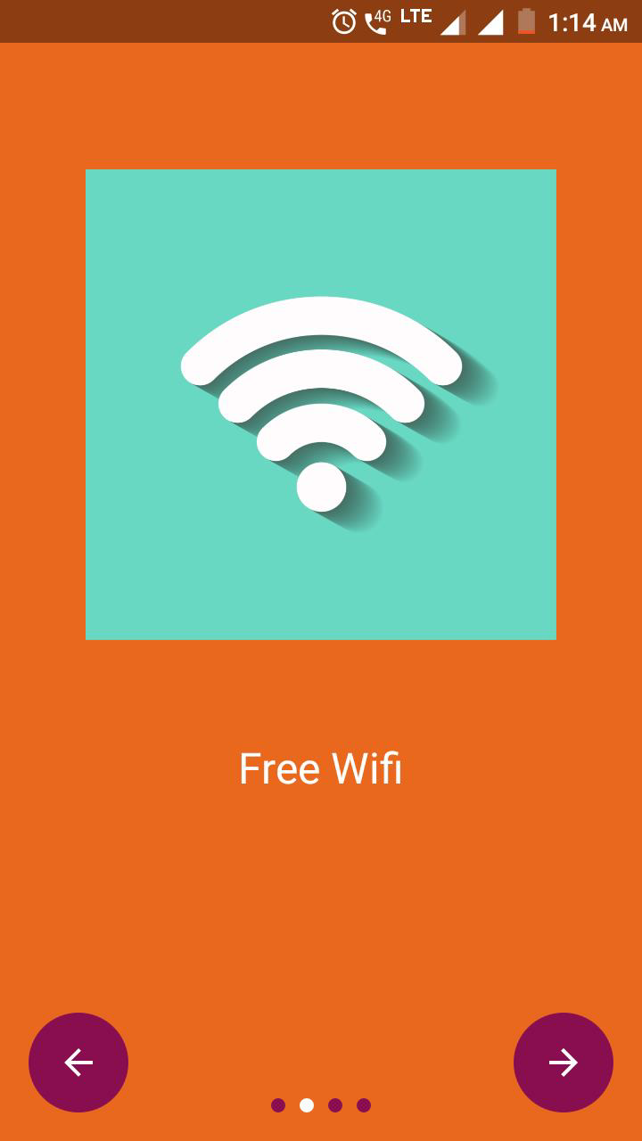
2nd Intro Page
“Free Wi-fi”
3rd Intro Page
“AC Rooms with breakfast free”

Slide 18
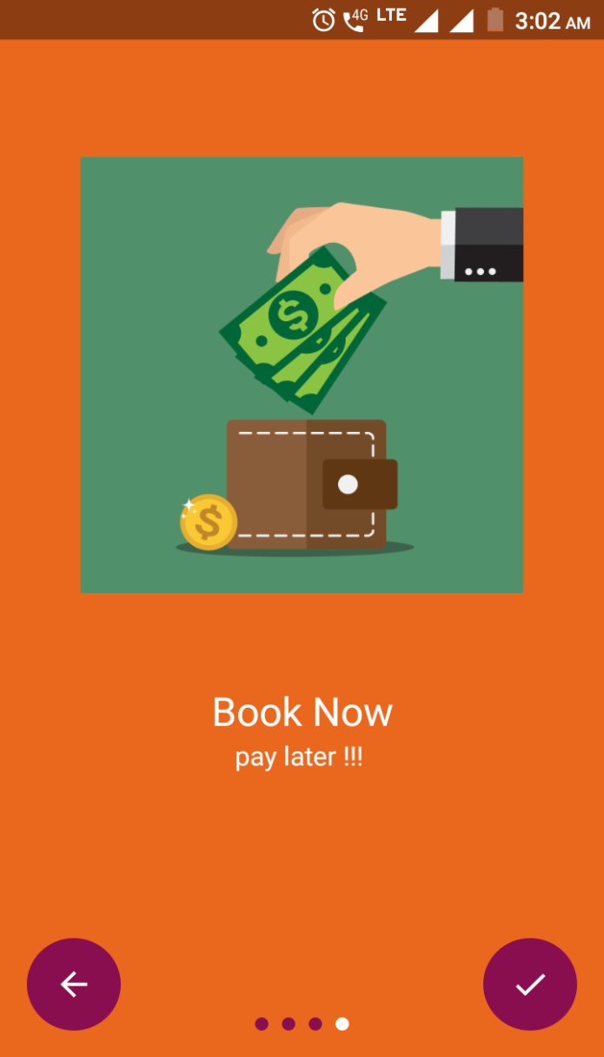
4th Intro Screen Page
“Book Anytime and pay at the time of checkout”
Check button or left swipe will lead user to our Login Page

Slide 19
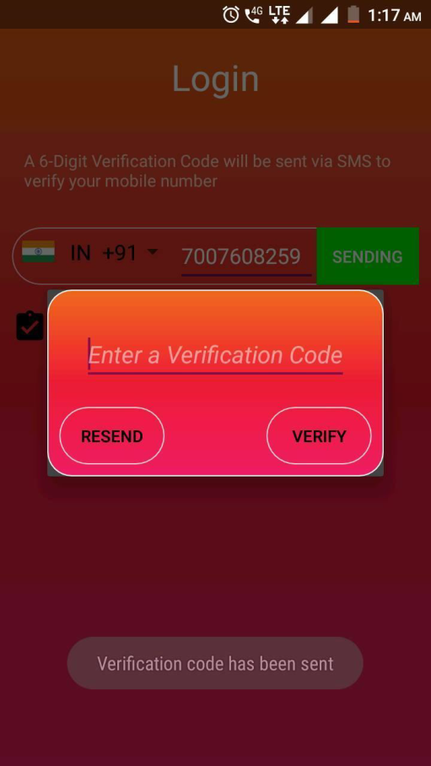
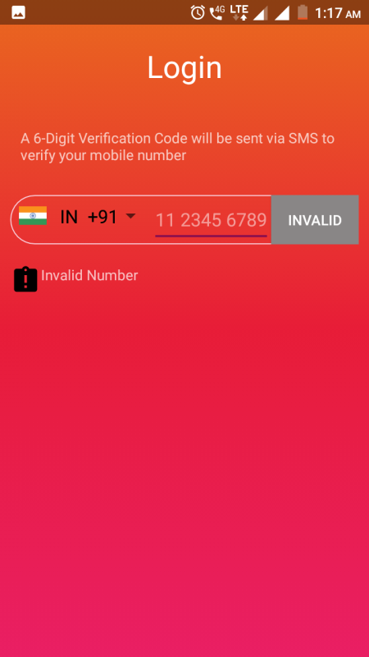
4.3. Login Page
4.4. Verification Dialog box
The user will encountered with the Phone Number input textbox with country code box (flag) on left of textbox and verify button to obtain the OTP for further verification.
When the user click on the verify button then the application will verify that whether the user is new or registered. And the OTP will be sent to the entered number.

Slide 20
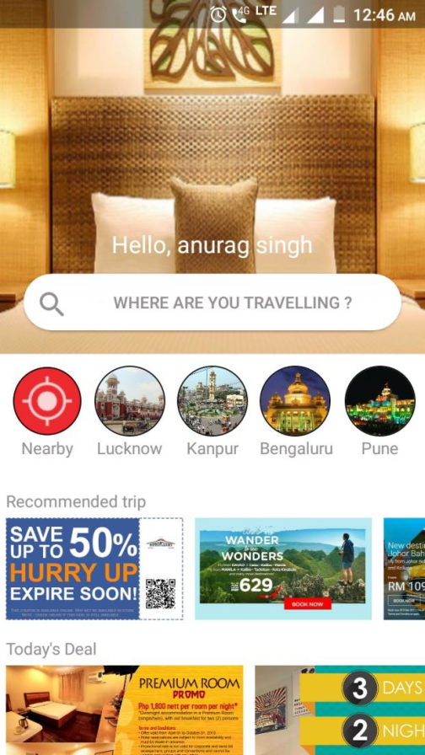
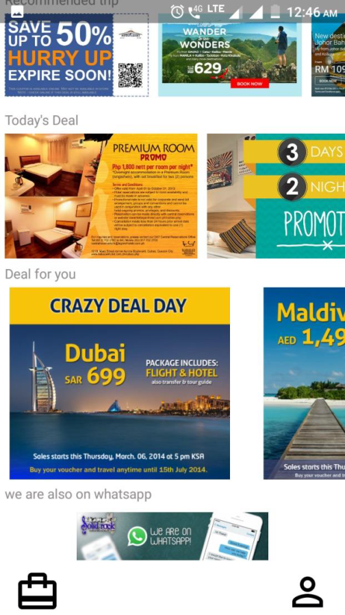
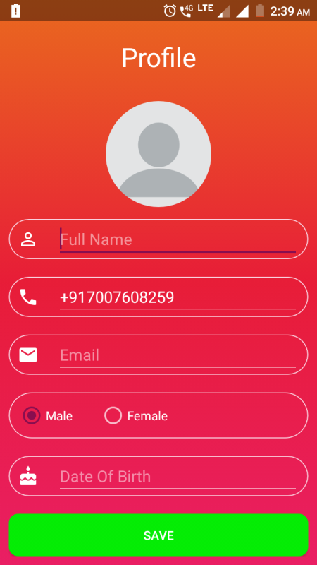
4.5. Registration Page
4.6. Home Page
It consists of different information that’s mandatory for the user to complete the registration process.
Home page is shown below in the screenshot

Slide 21
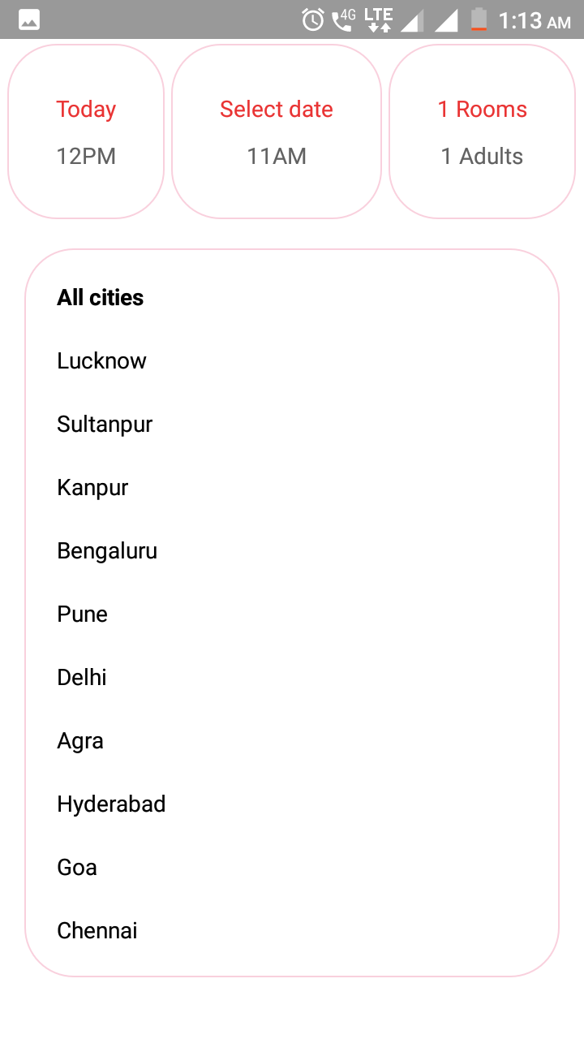
4.7. Search Localities
Check in, check out and number of guests with number of rooms
Some selected cities which are collaborating with us.

Slide 22
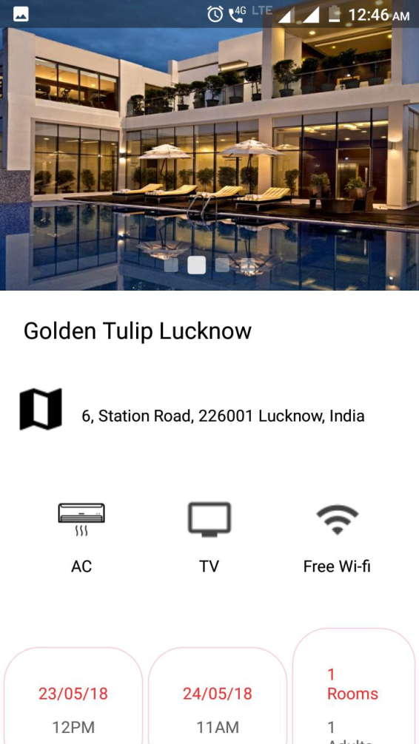
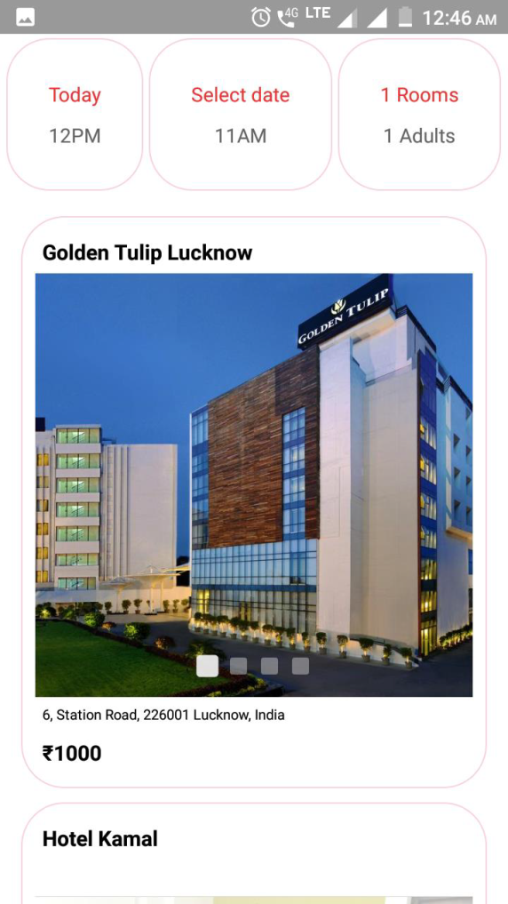
4.8. Booking process
Let us suppose the user want to book a hotel in lucknow.
Step 1: Click on the Lucknow city icon.
Step 2: Select the hotel along with arrival and departing date.

Slide 23
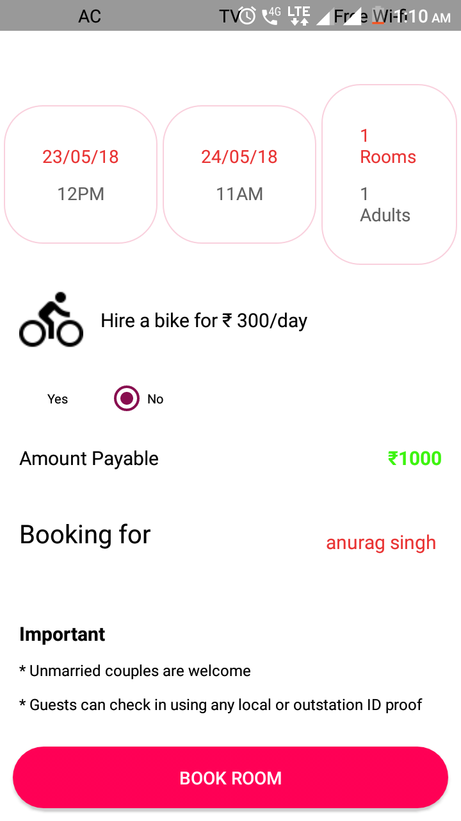
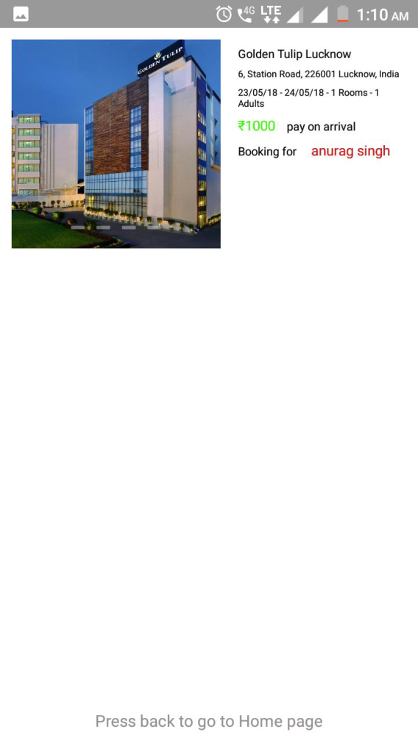
Step 3: The user can hire a bike at very nominal charges and can change guest name at the time
of booking
Step 4: The user have to click on “BOOK
ROOM” to confirm the booking

Slide 24
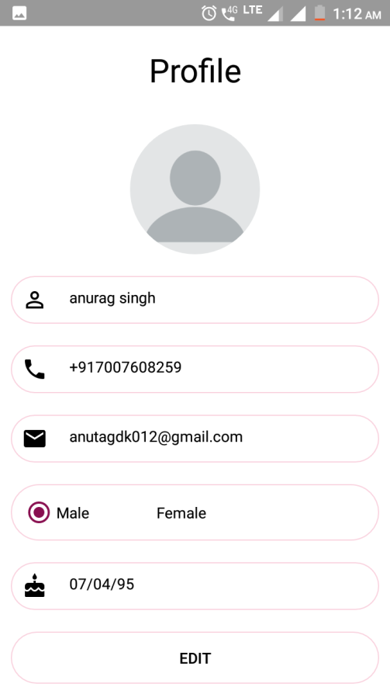
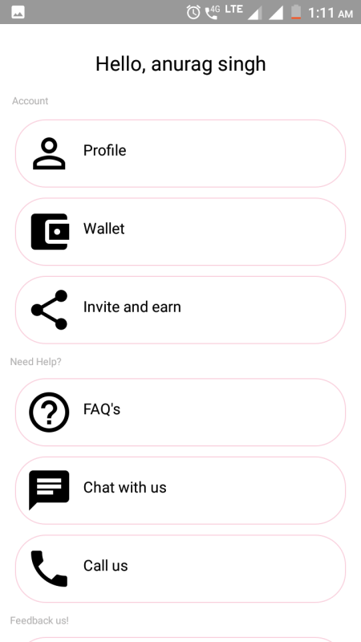
4.9. User Profile
4.10. Profile page
Different help and support services are also provided by the application which includes FAQs, feedback regarding to their booking, their experience using the application for booking.
The user can logout the session from the account section.
profile page where user can easily make the changes.

Slide 25
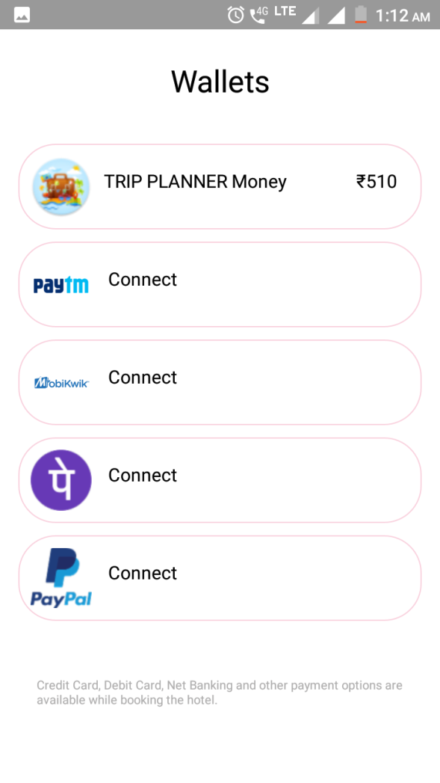
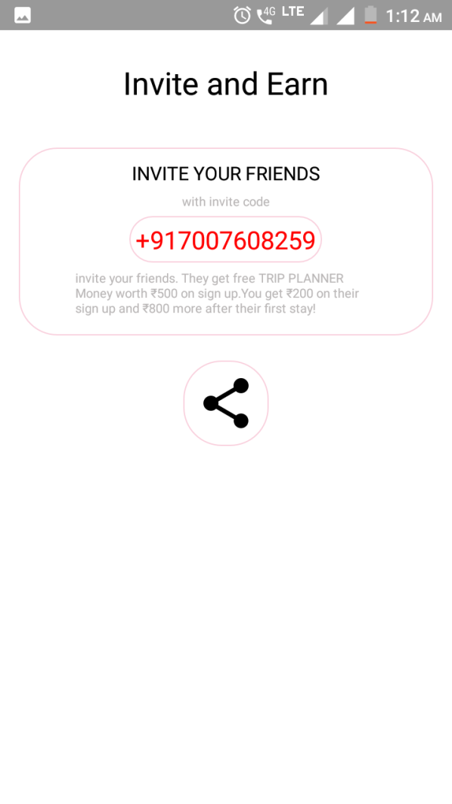
4.11. Payments and Wallet
4.12. Refer and earn
The application also supports different latest payment options based on paytm and UPIs .
A cool stuff in the application which provides the user to earn some extra cash by referring a friend to join trip planner.

Slide 26
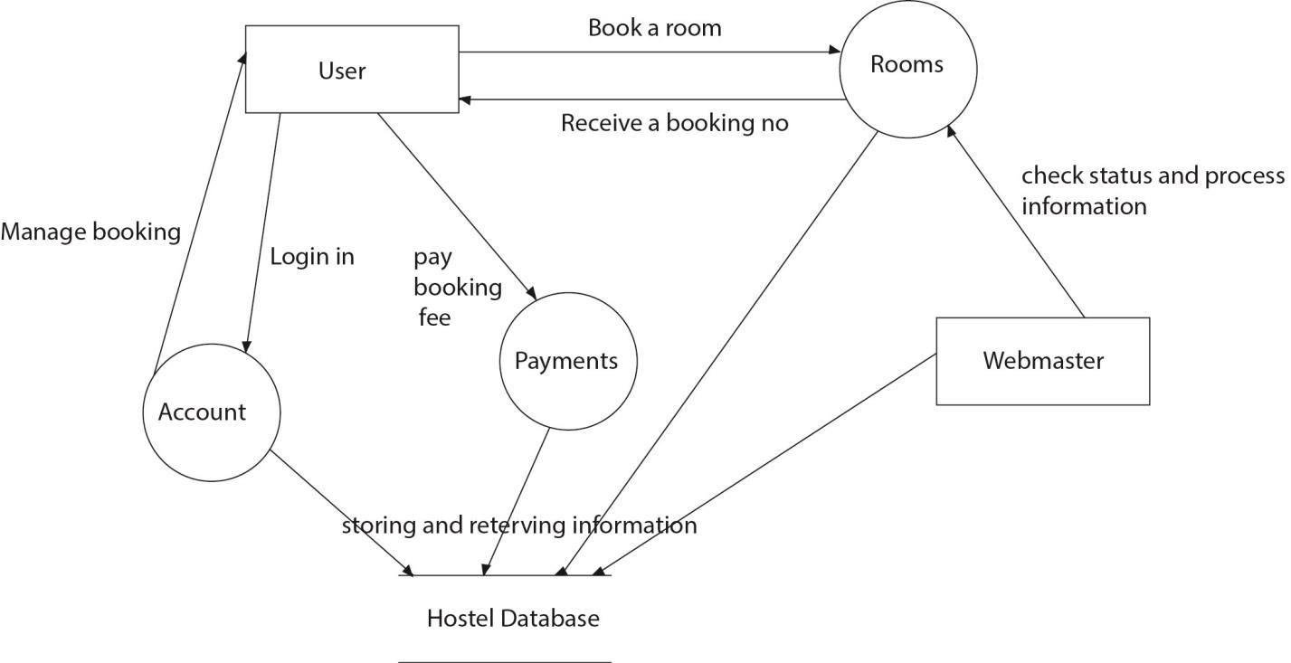
Chapter 5.
Data flow Diagram (DFD)

Slide 27
CONCLUSION
The application is focused only on booking hotels. As of now, the number of customers is
growing rapidly and numbers of hotels are also very high, so that a customer must have some
enhanced technology and mechanism to make all the process easy and fluent. Booking Hotel
is very essential task and it should be easy. This application makes this very handy and facile.
Hence, here we come with the idea of making some superficial platform like an android
application which is in reach of most of the common smart phone users. This application
allows users to book hotel rooms through android phones. To use this application user may
require android phone along with internet connection.

Slide 28
REFERENCES
1. www.wikipedia.org
2. www.firebase.google.com
3. www.stackoverflow.com
4. www.github.com
5. www.android-arsanel.com

